Slide 1

Ecmascript 6
Dev-Pro Node Advanced. - Lecture -0

Slide 2


Agenda:
ES6 new features
Arrow functions and lambdas
Iterators and Generators
Modules
Proxies

Slide 3
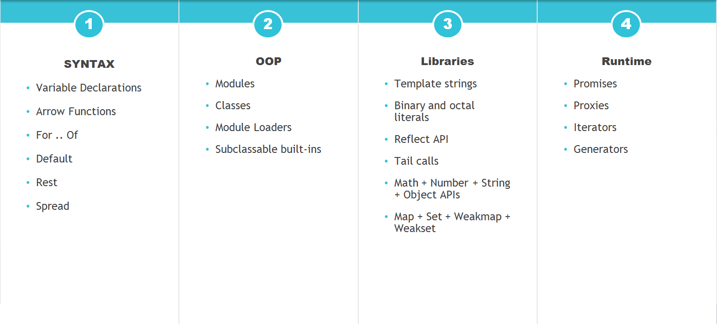
Ecmascript 6. What is new?

Slide 4
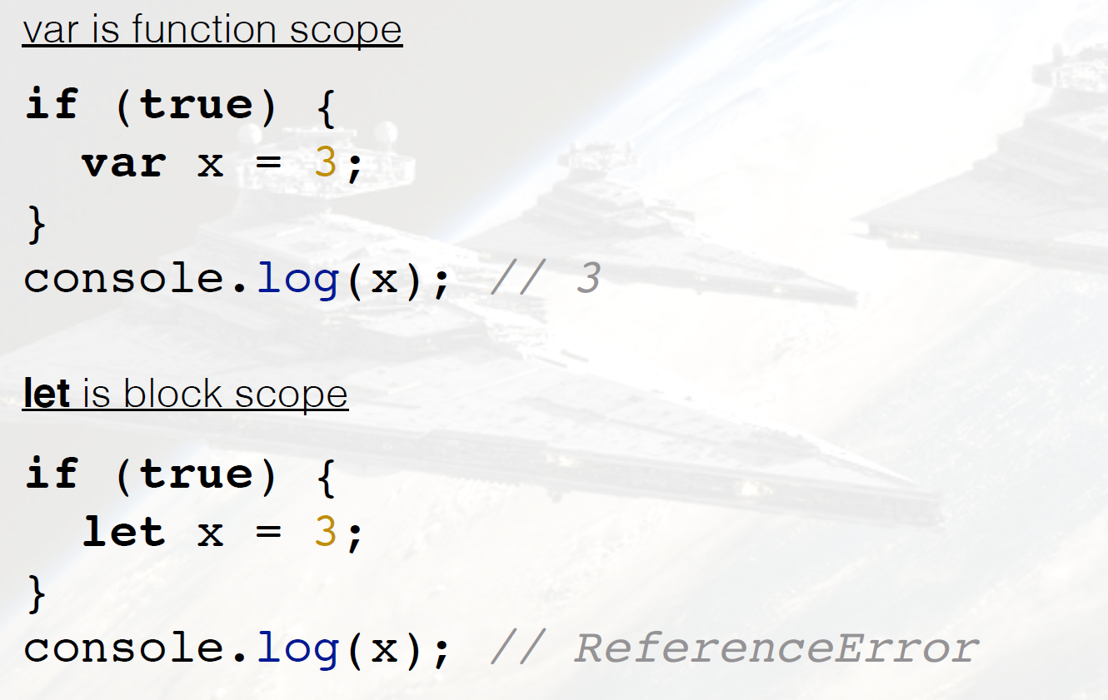
Declaration and Scoping

Slide 5
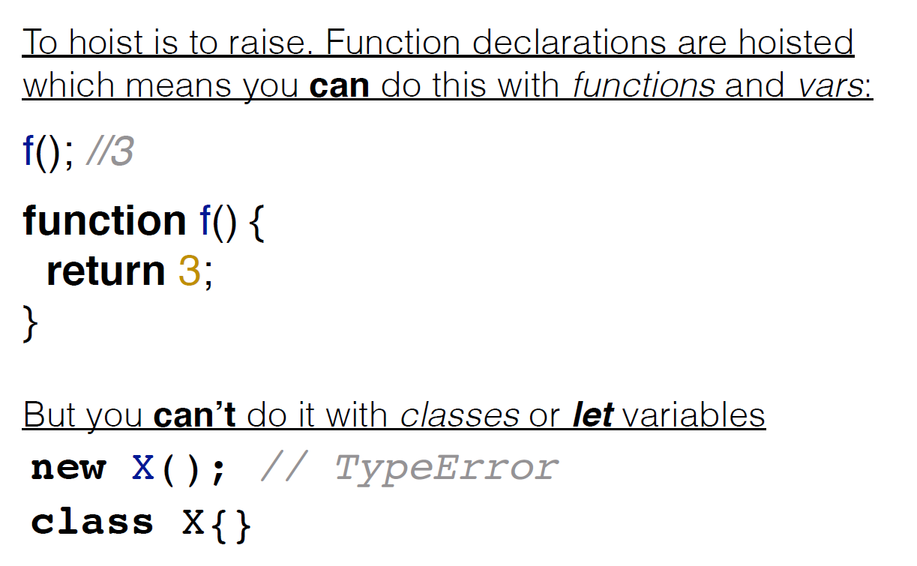
Declaration and Scoping

Slide 6
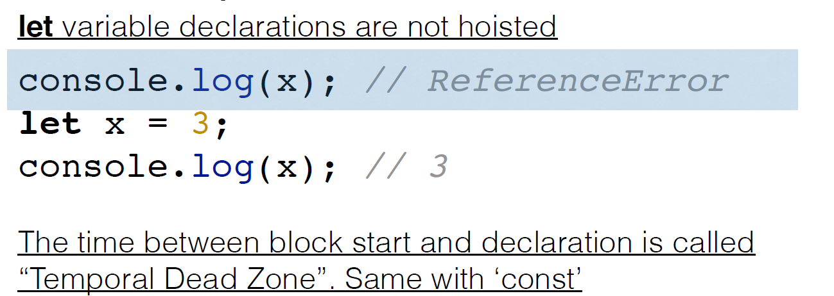
Temporal dead zone

Slide 7
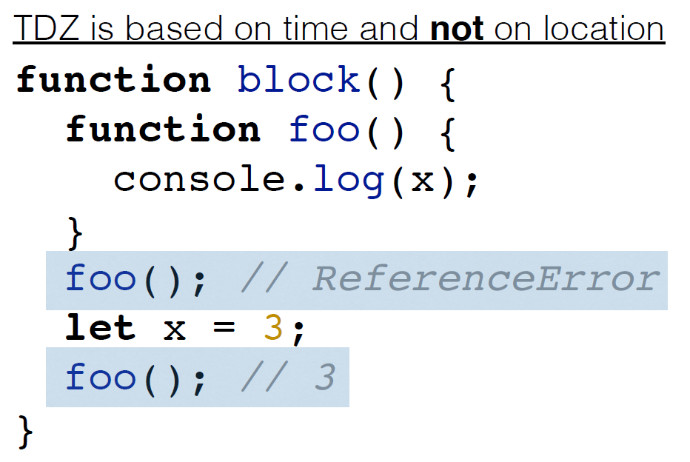
Temporal dead zone

Slide 8
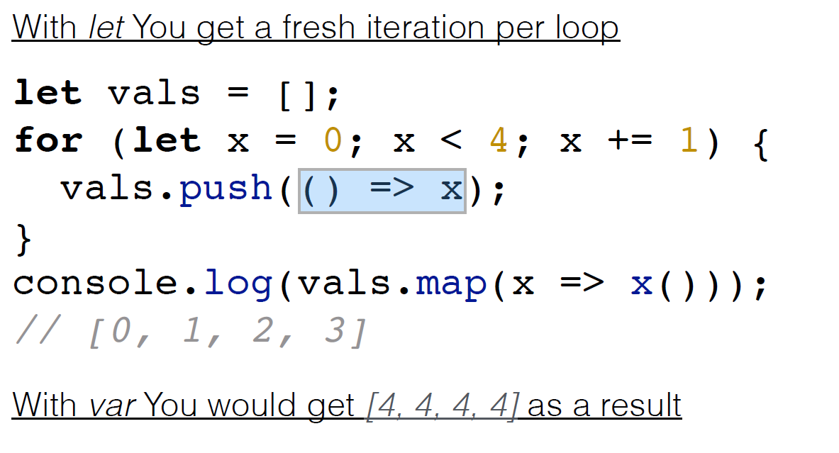
Loop scoping

Slide 9
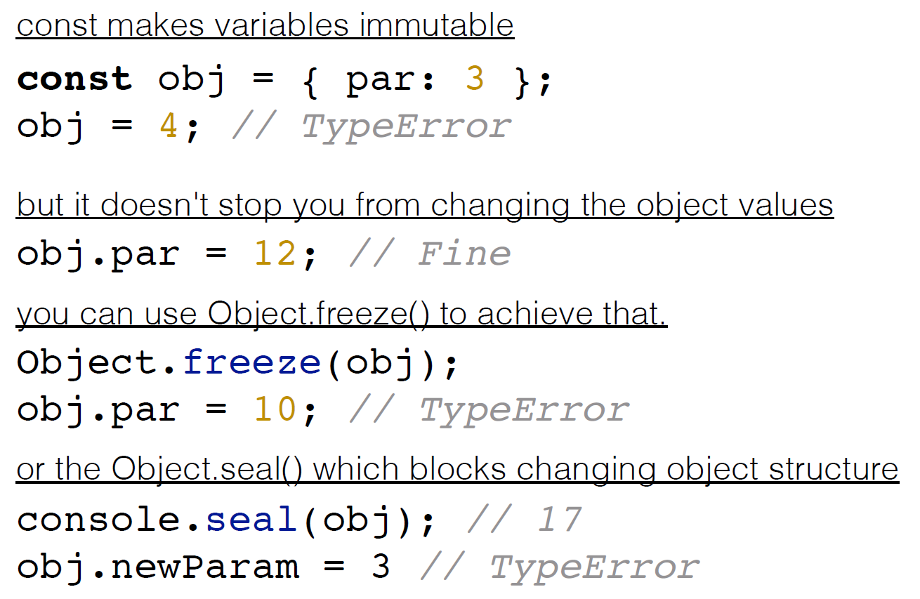
CONST

Slide 10
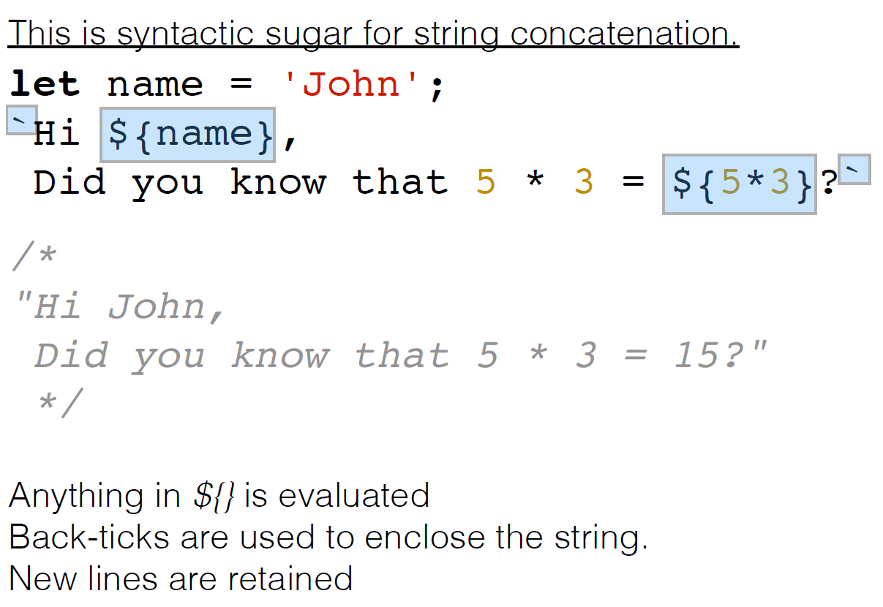
String templates

Slide 11
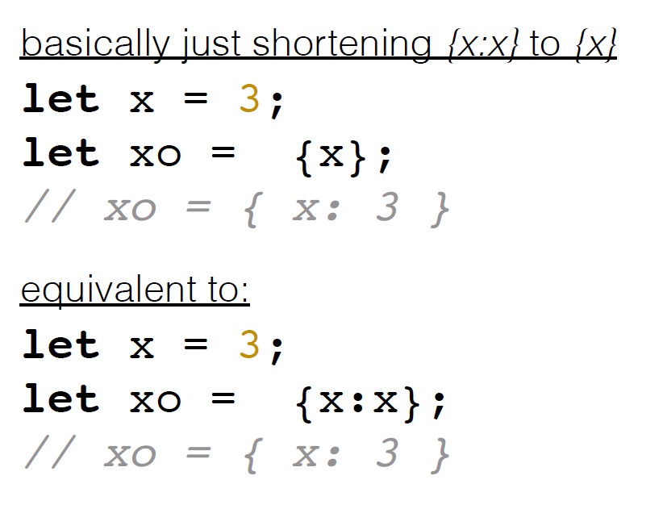
Enhanced object literals

Slide 12
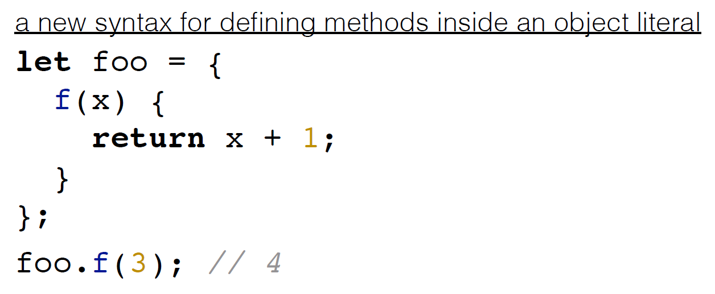
Method defenition

Slide 13
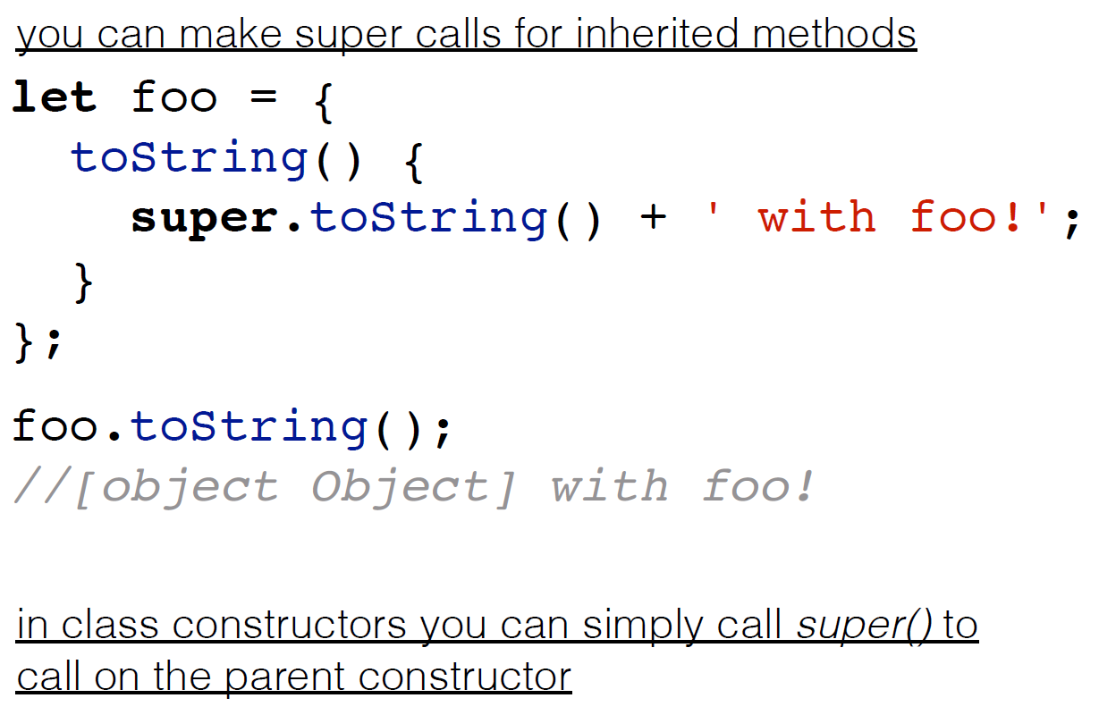
Super

Slide 14
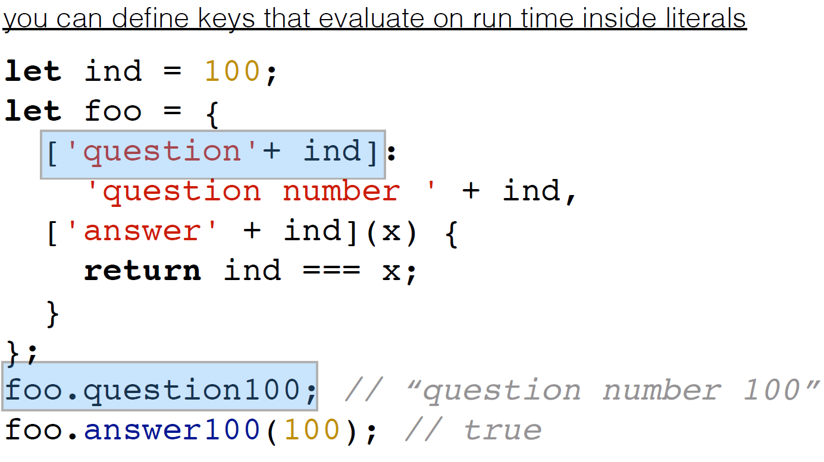
Computed properties

Slide 15
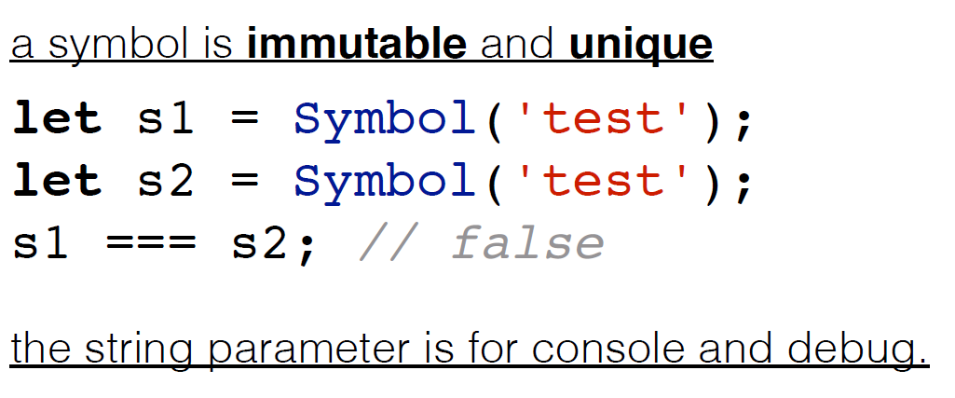
Symbol

Slide 16
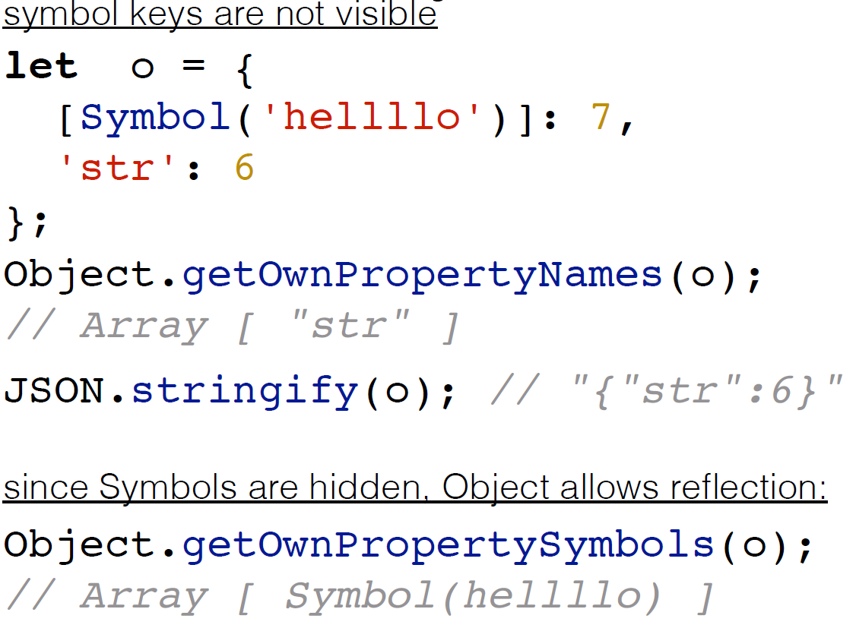
Symbol

Slide 17
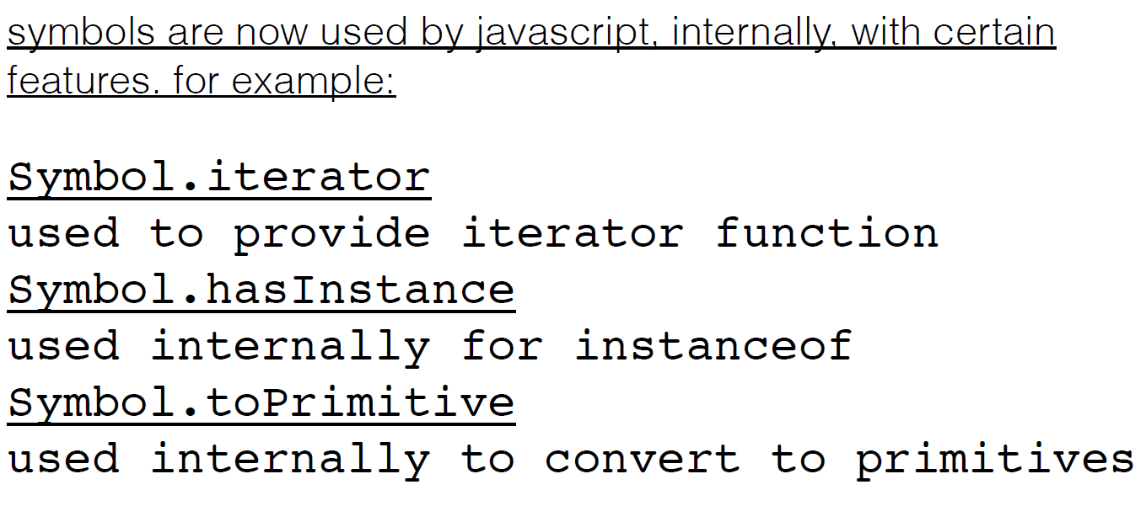
Symbol

Slide 18
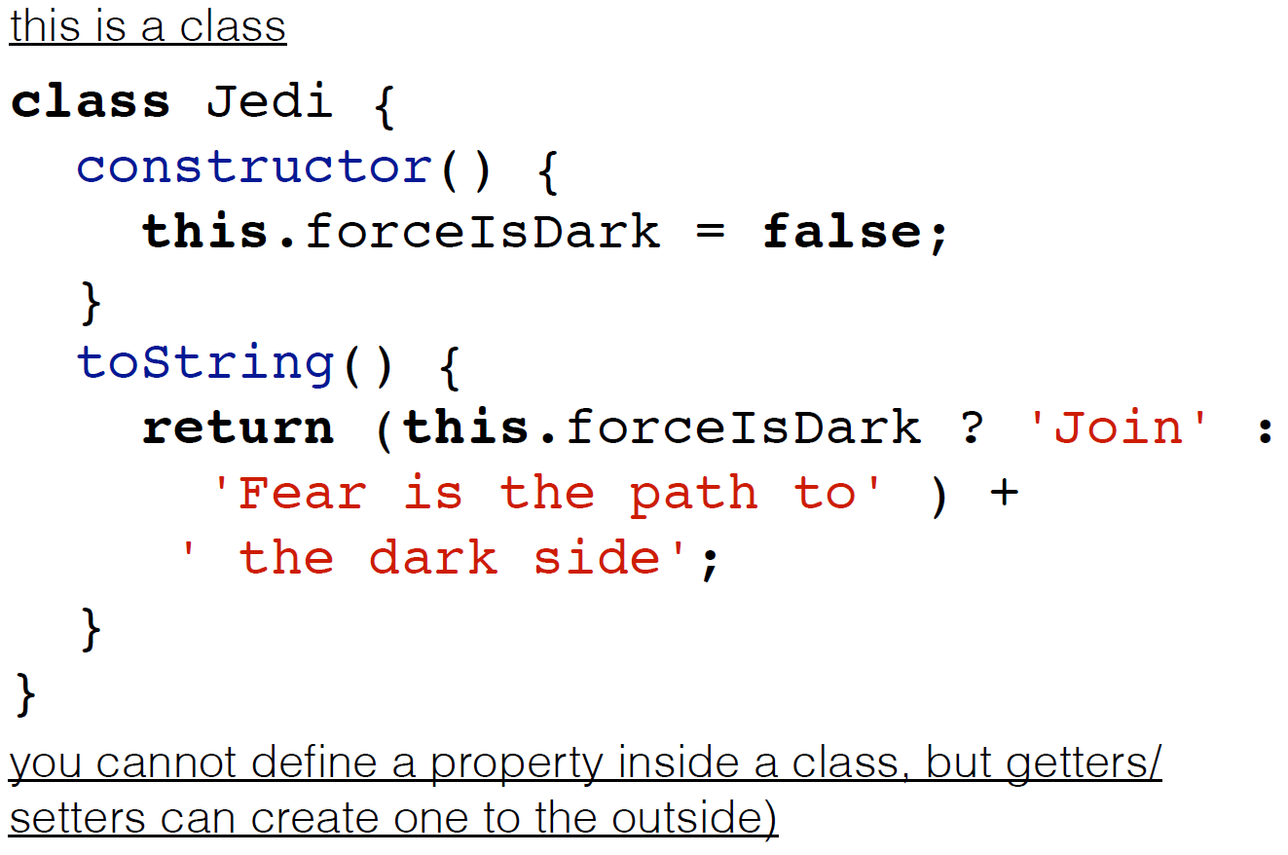
Classes

Slide 19
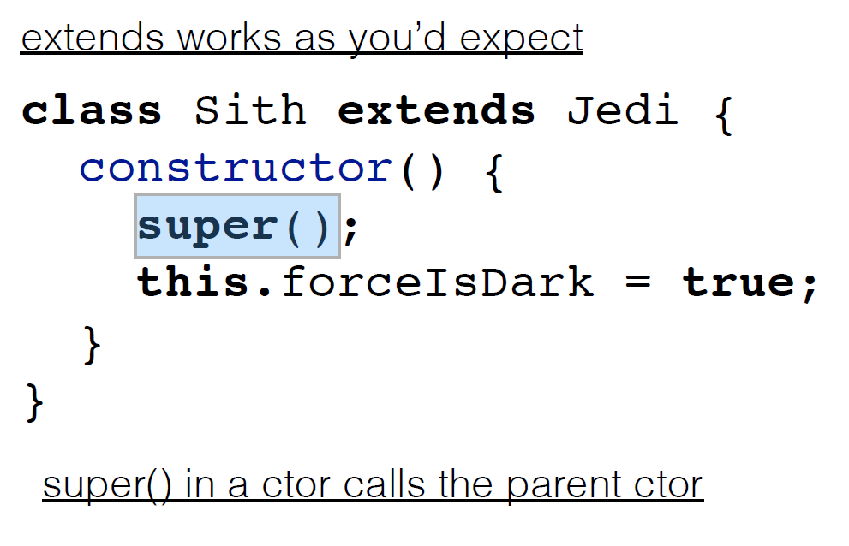
Inheritance

Slide 20
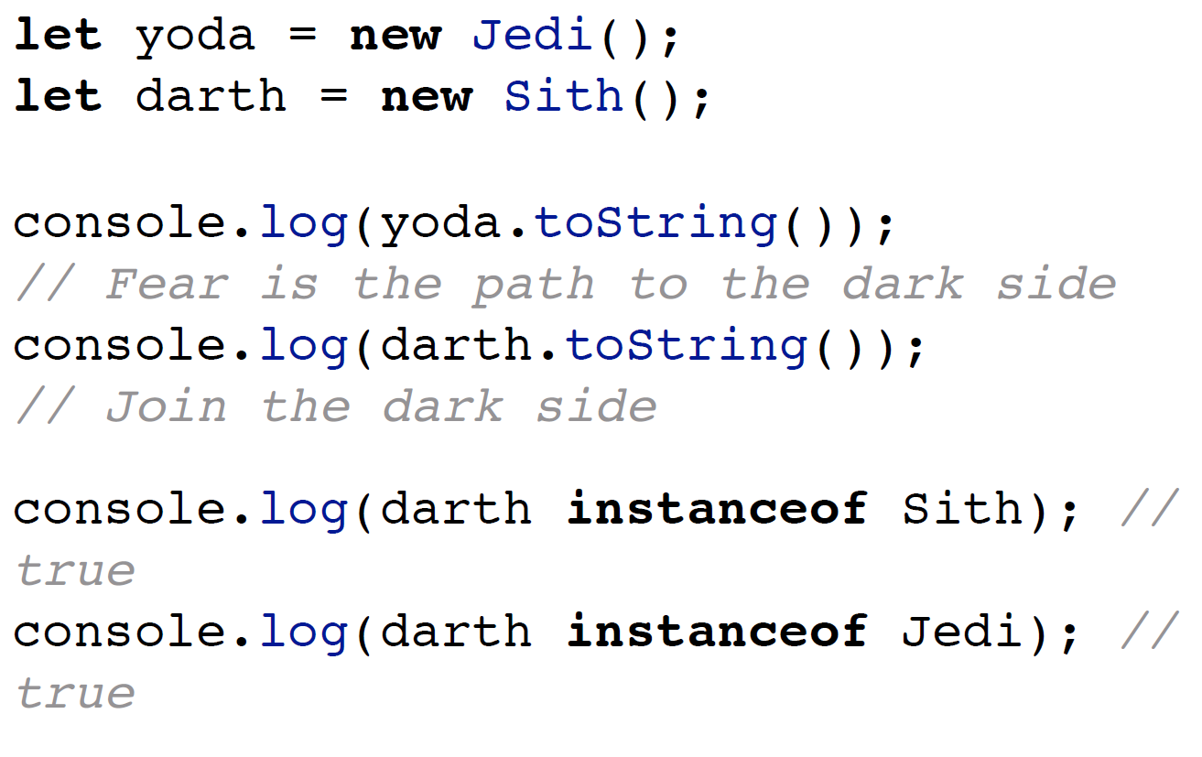
Inheritance – REAL inheritance

Slide 21
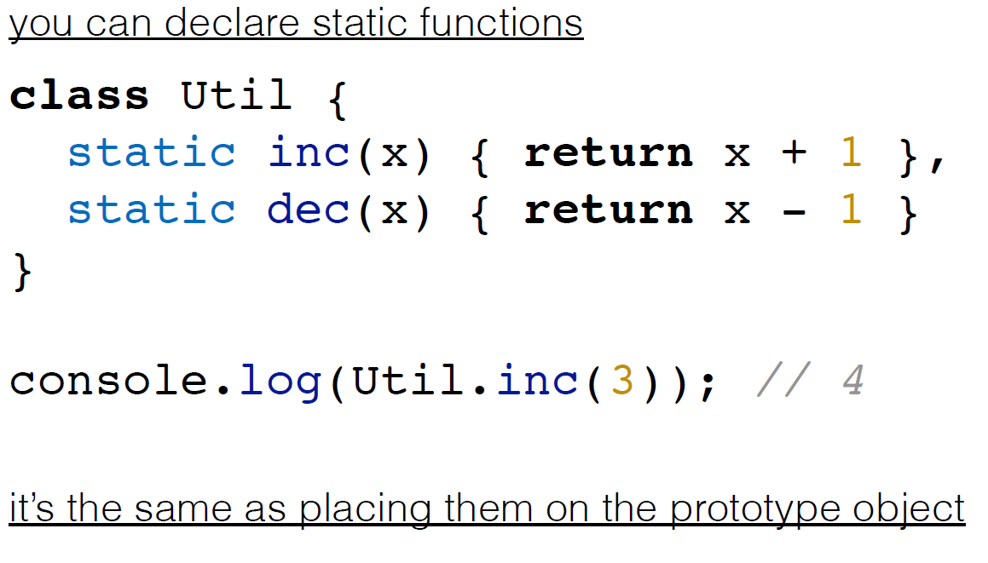
Static

Slide 22
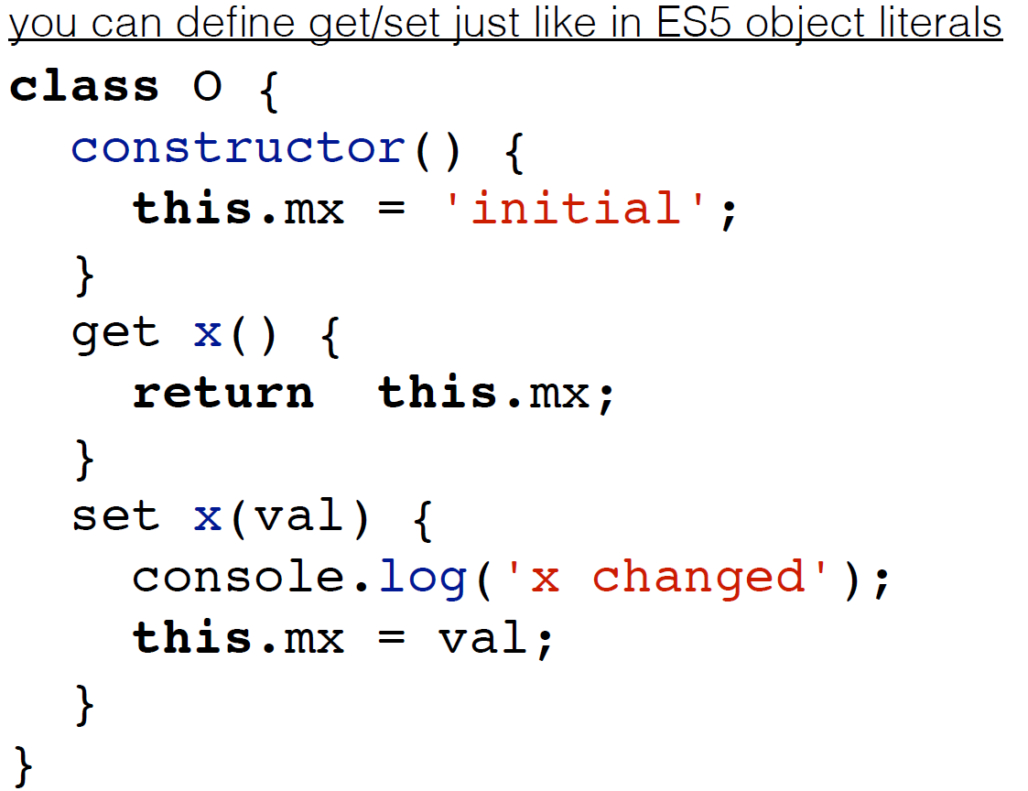
Getters and setters

Slide 23
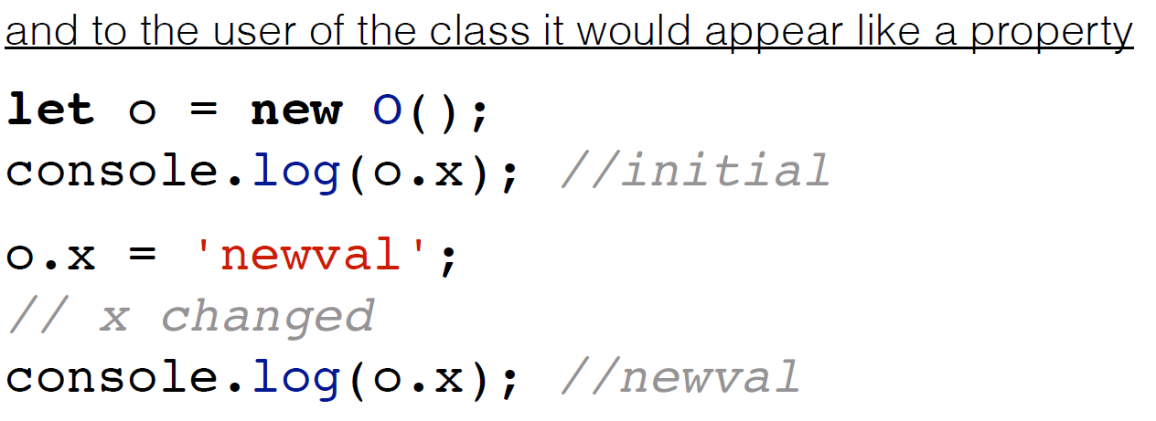
Getters and setters

Slide 24
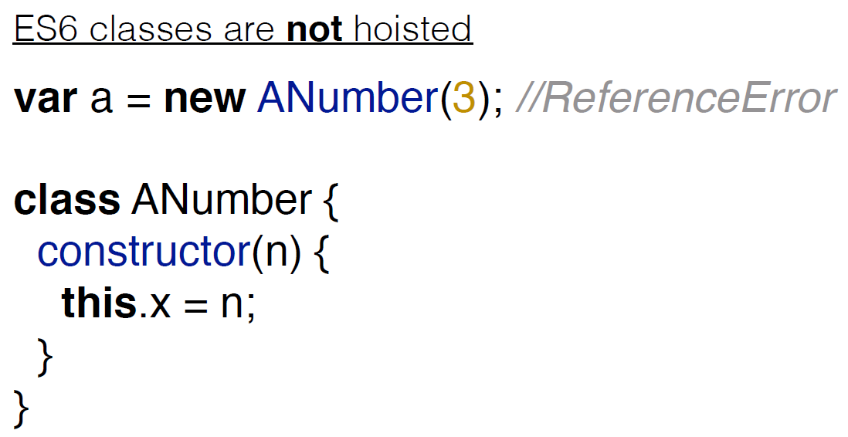
And Hoisting again

Slide 25
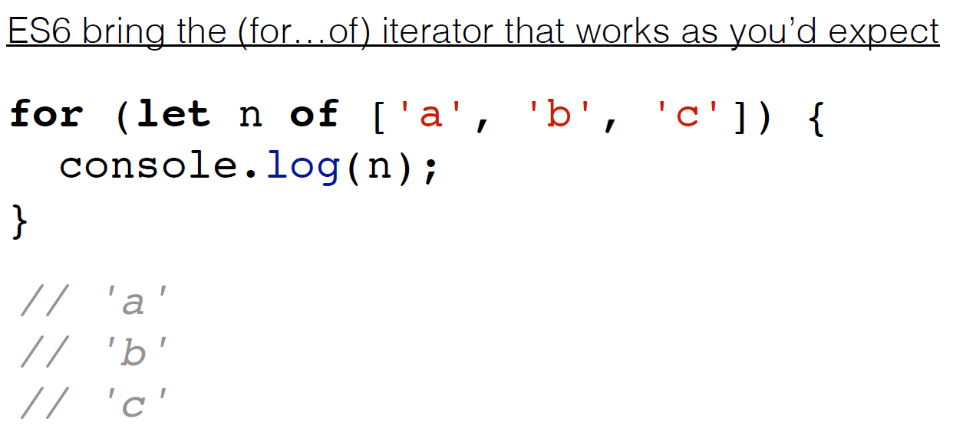
Iterator protocol

Slide 26
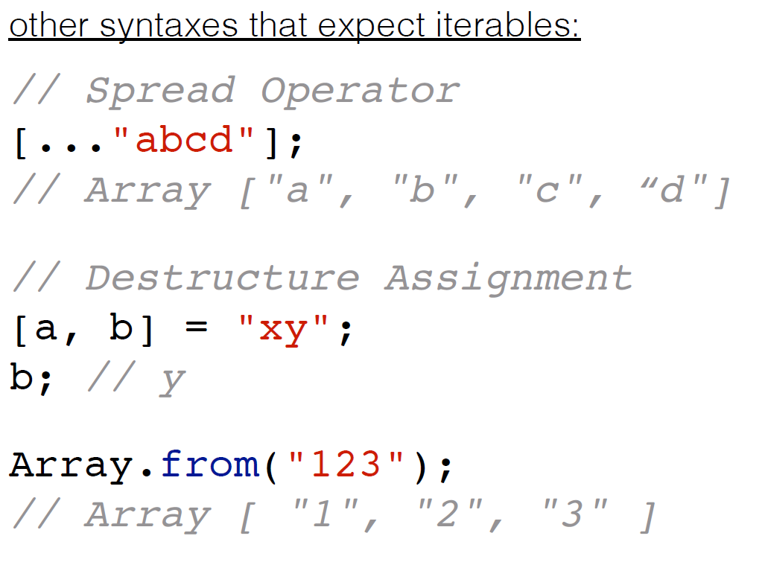
Iterators example

Slide 27
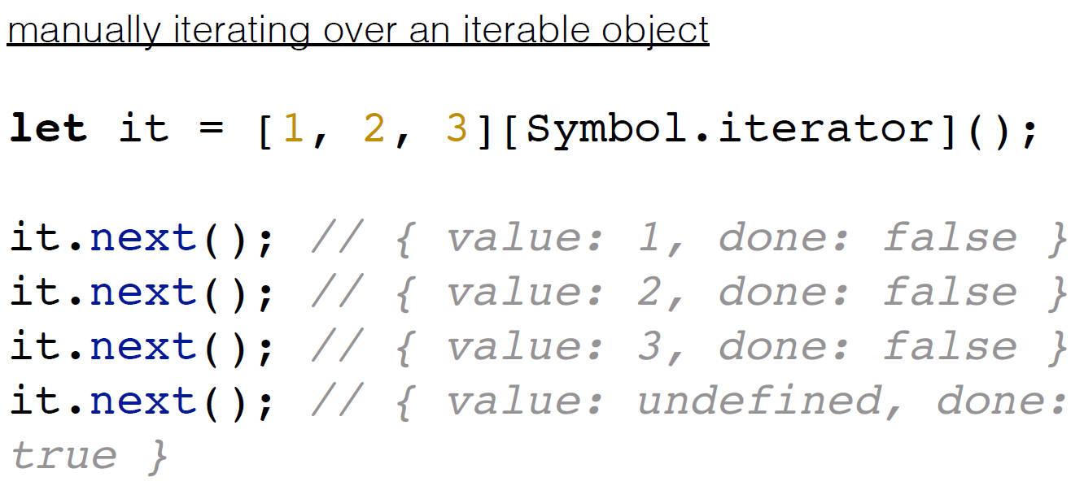
Iterators example

Slide 28
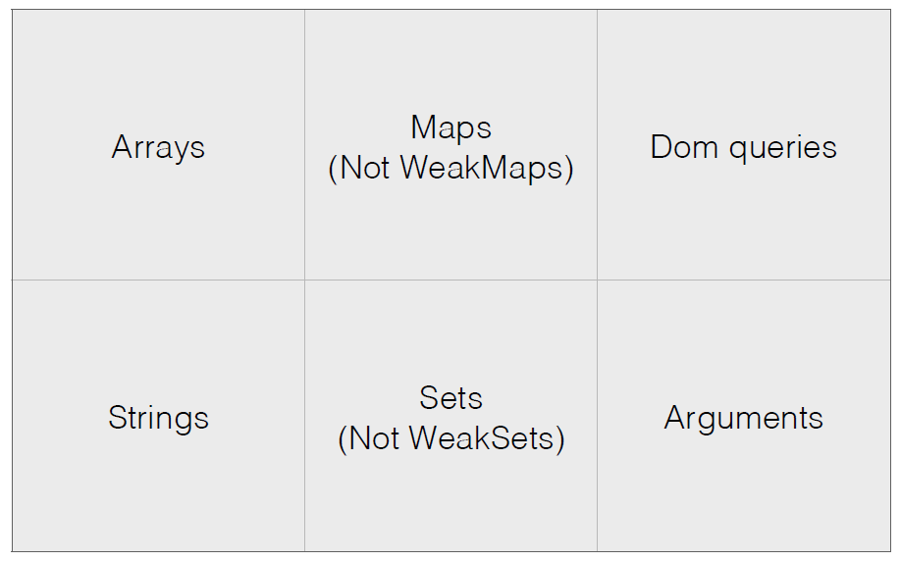
Iterable data sources

Slide 29
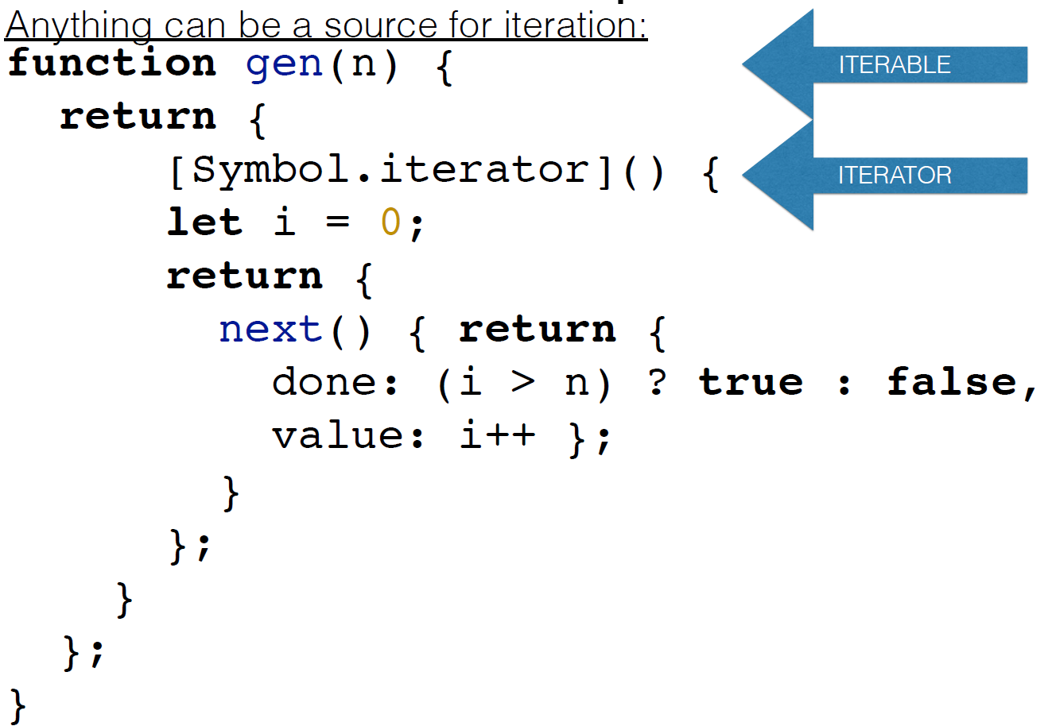
Self maked iterator

Slide 30
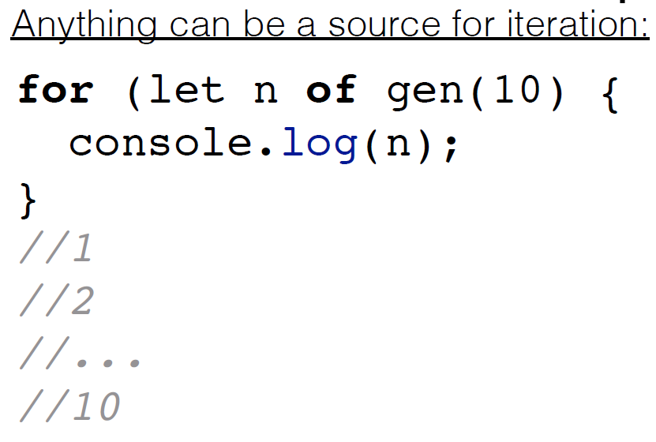
Invoke iterator

Slide 31
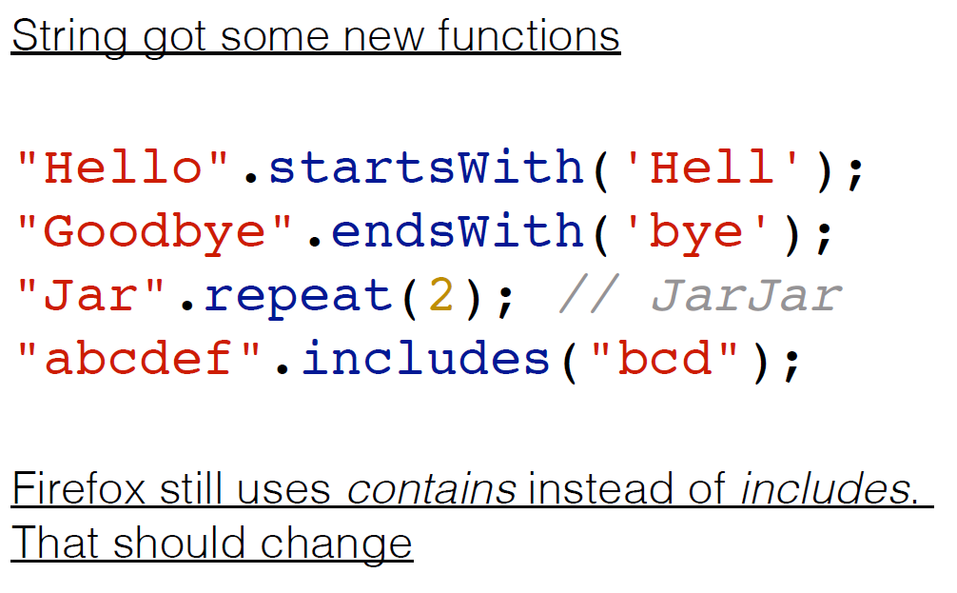
String

Slide 32
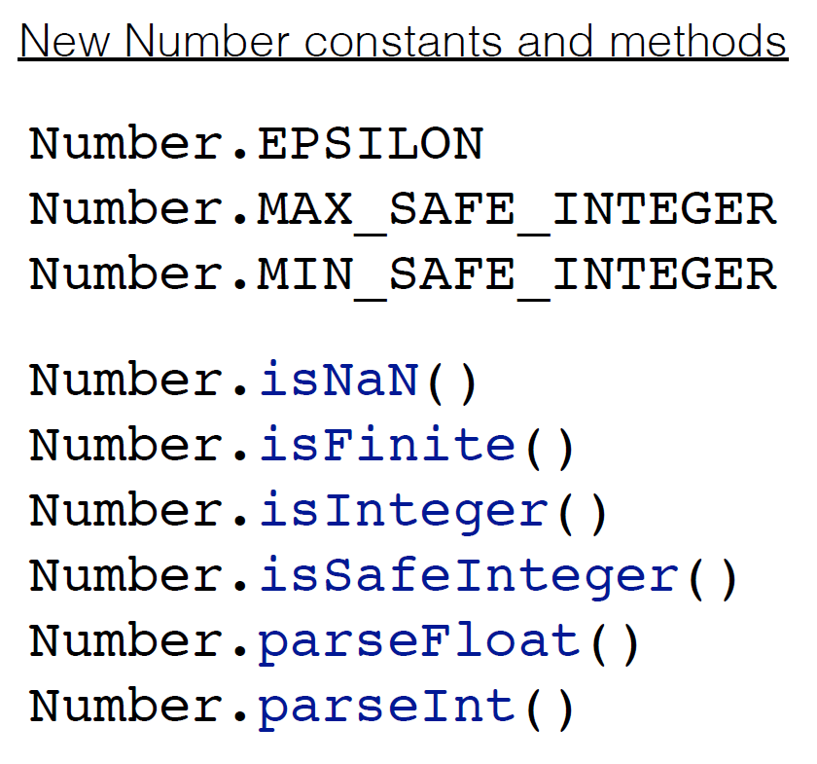
Number

Slide 33
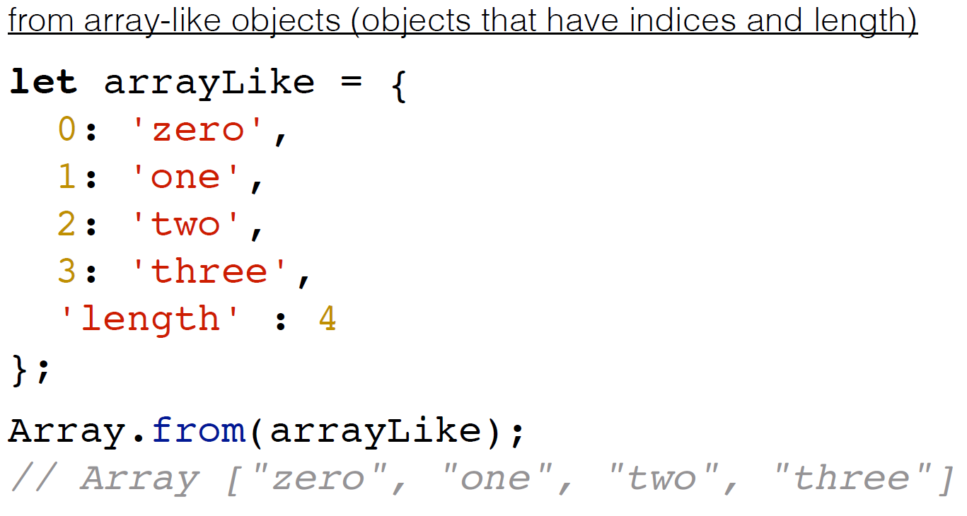
Array

Slide 34
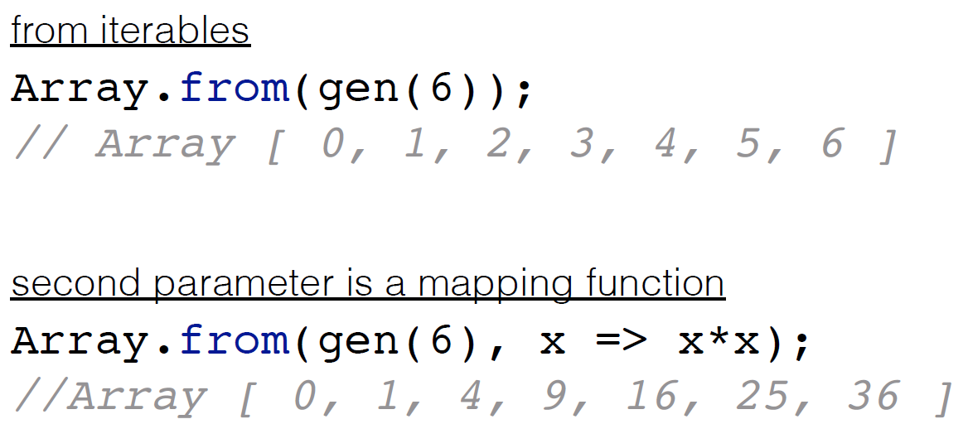
Custom generator and array.from

Slide 35
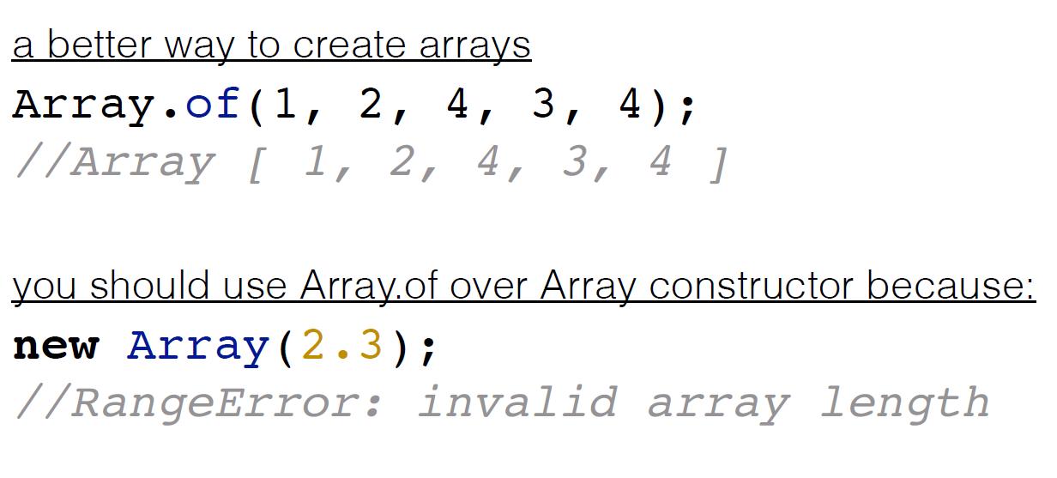
Array

Slide 36
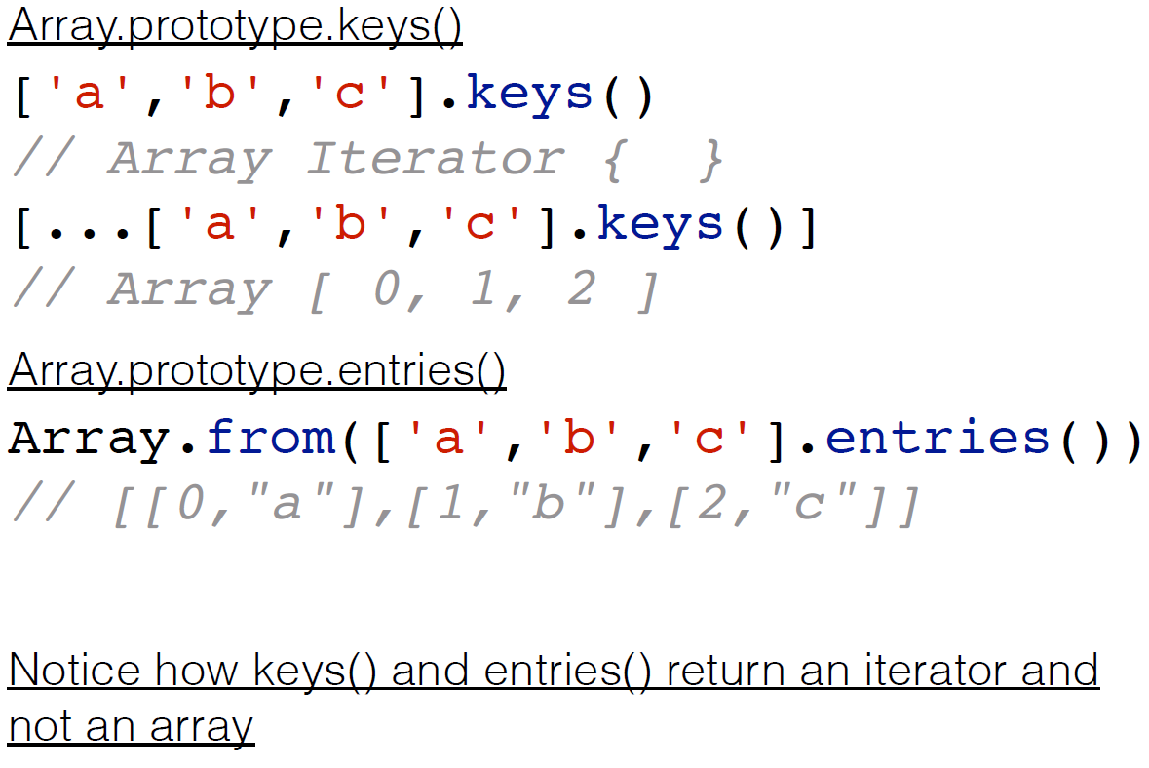
Array

Slide 37
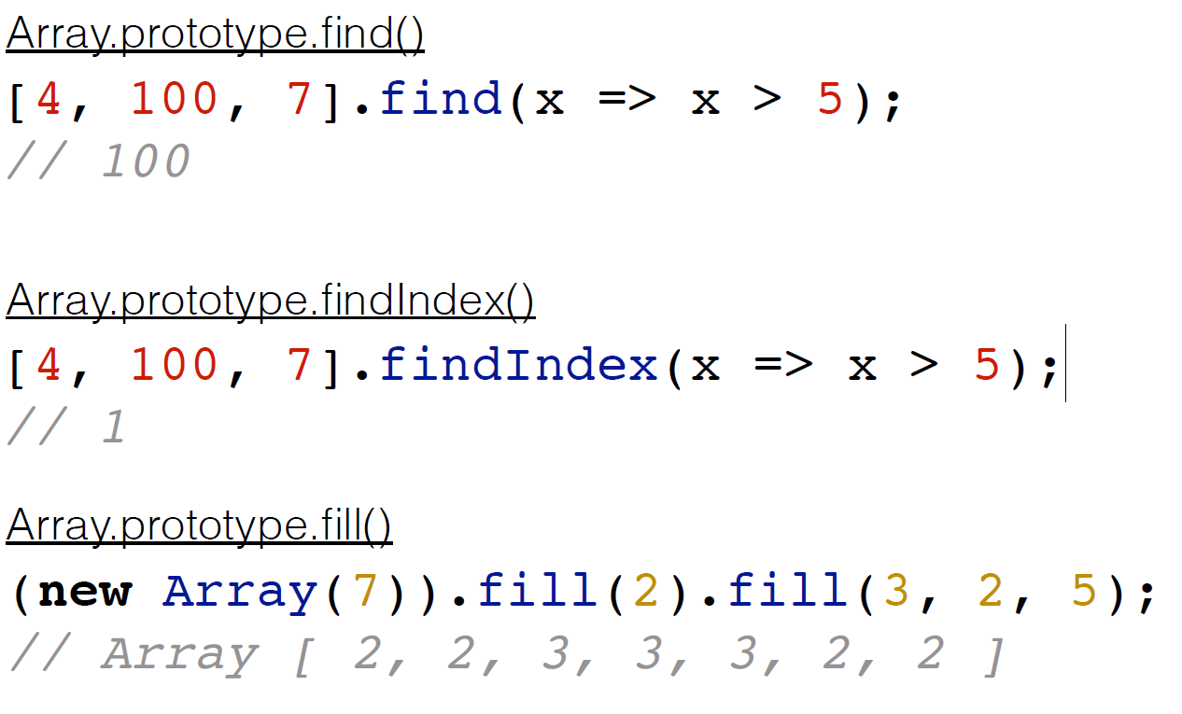
Array

Slide 38
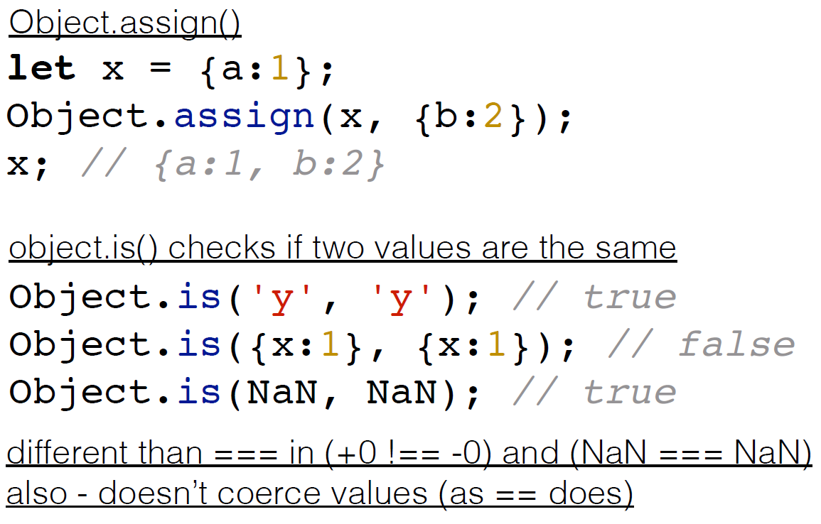
Object

Slide 39
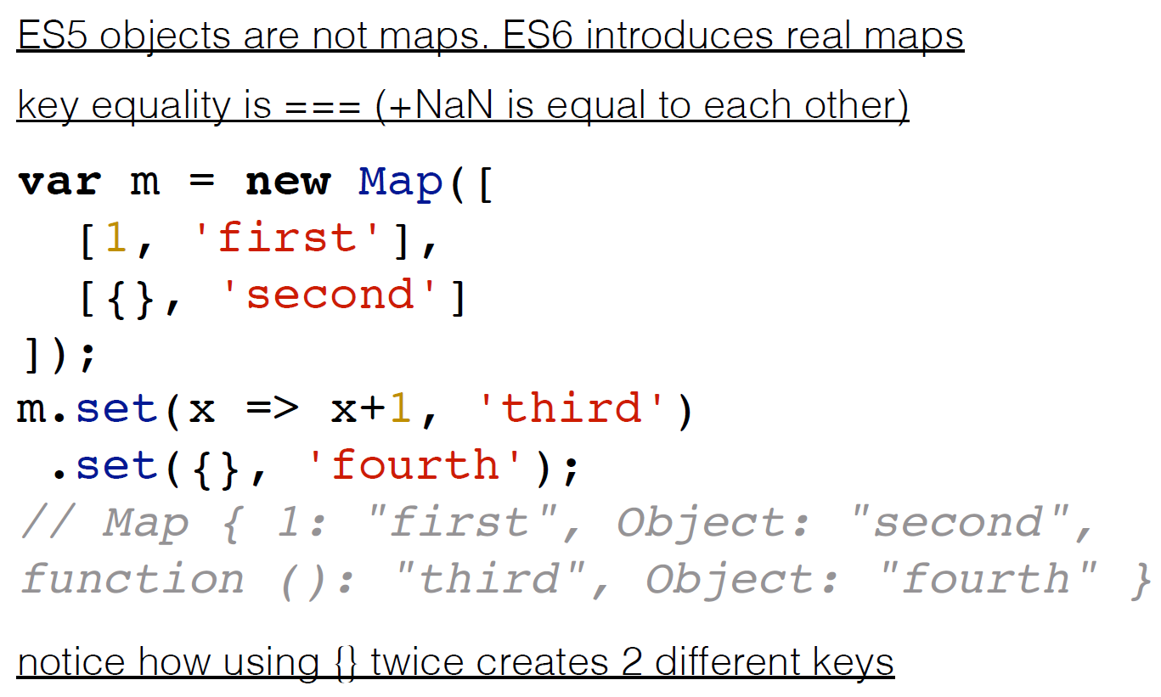
Map

Slide 40
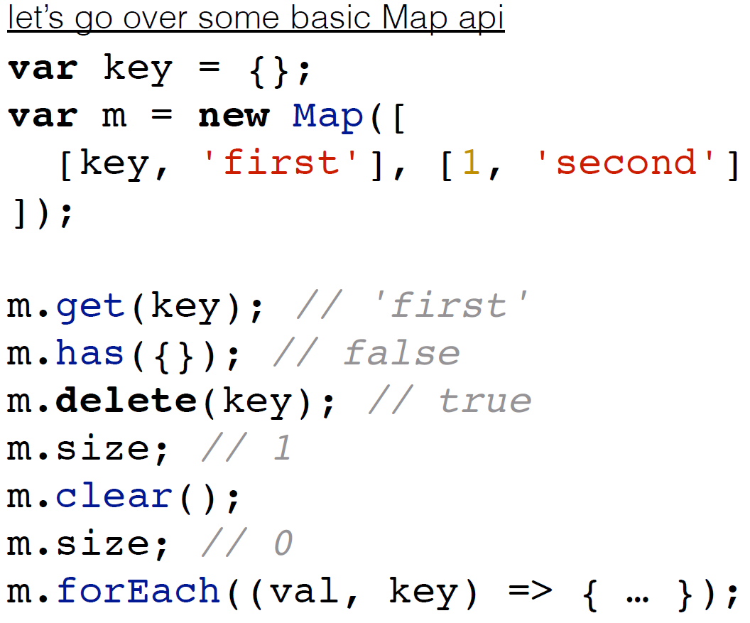
Map

Slide 41
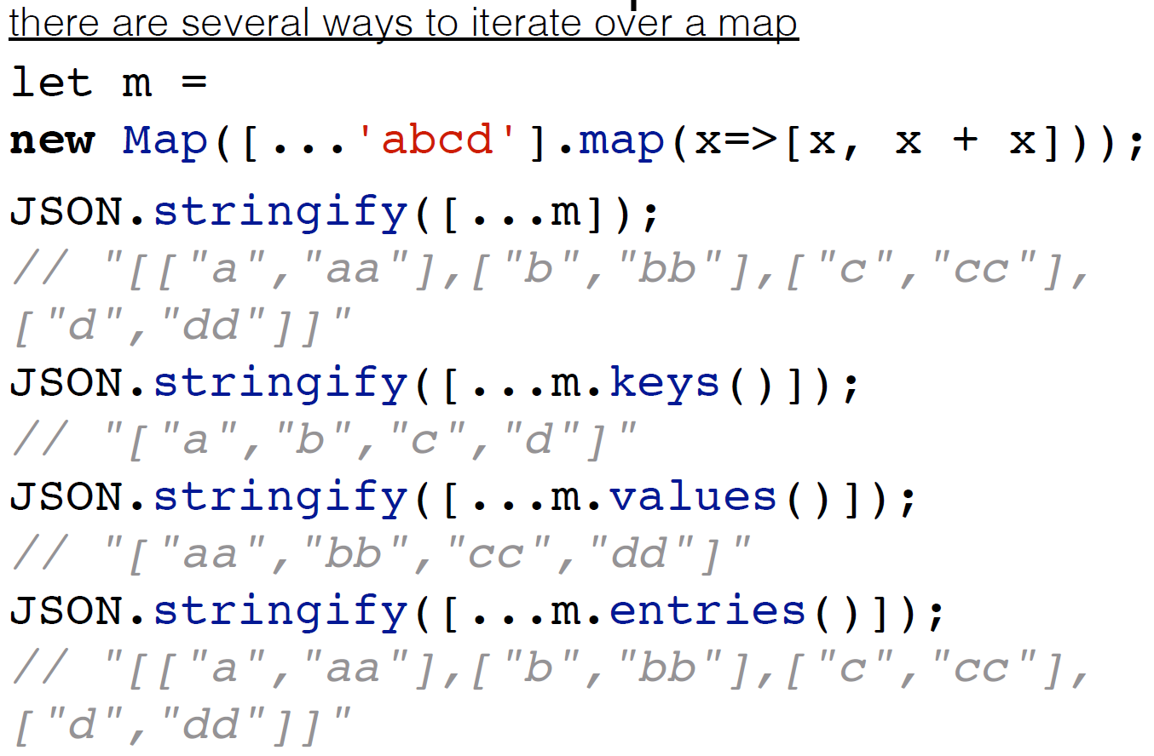
Map

Slide 42
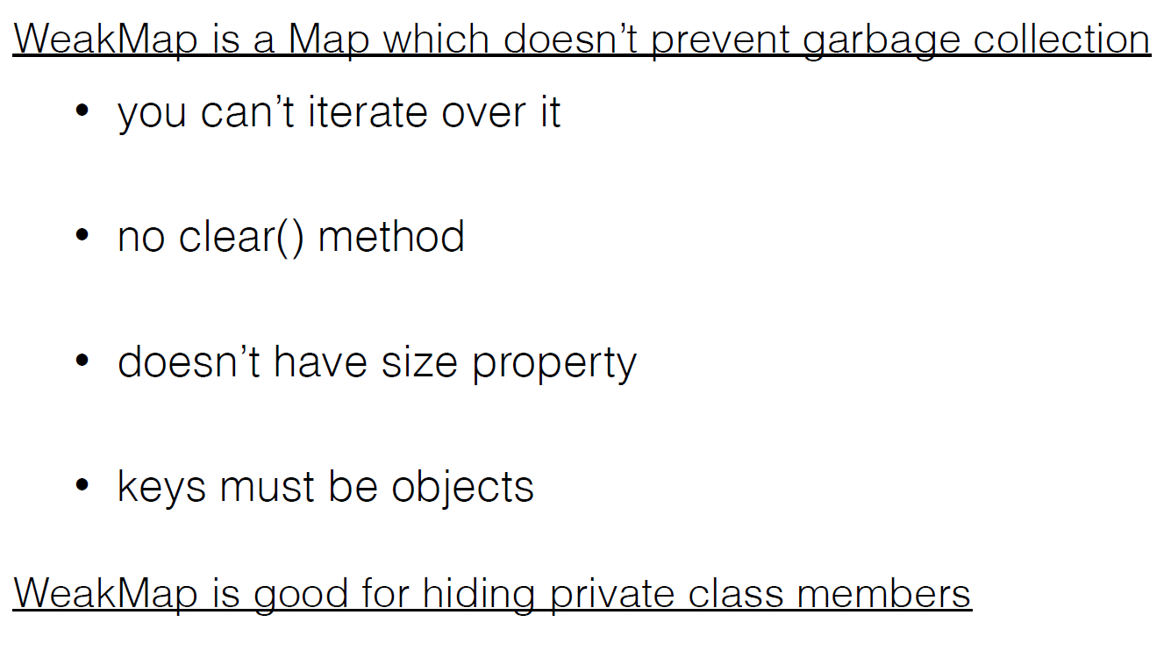
Weak map

Slide 43
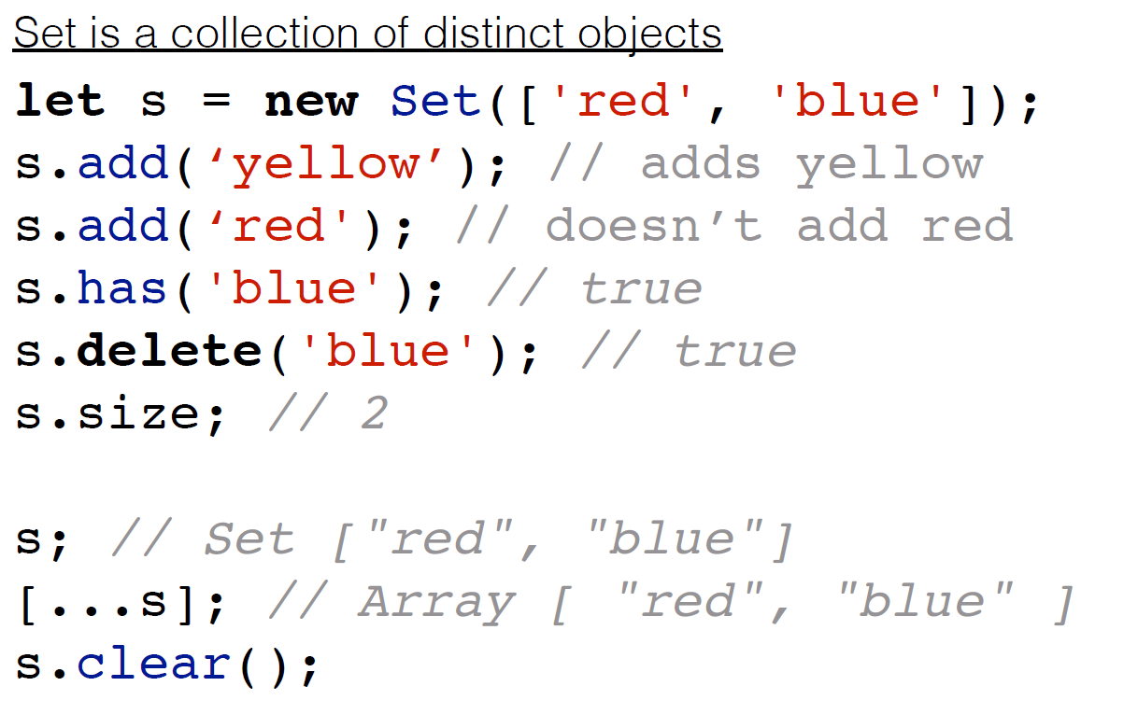
Set

Slide 44
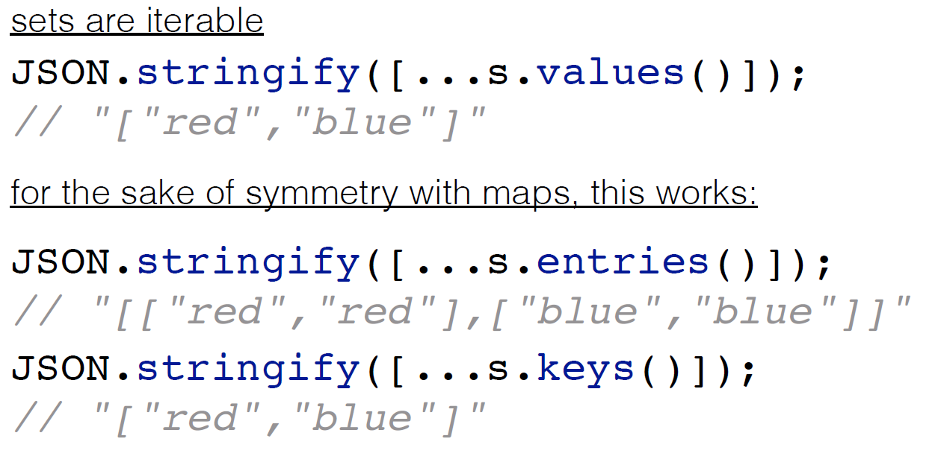
Set

Slide 45
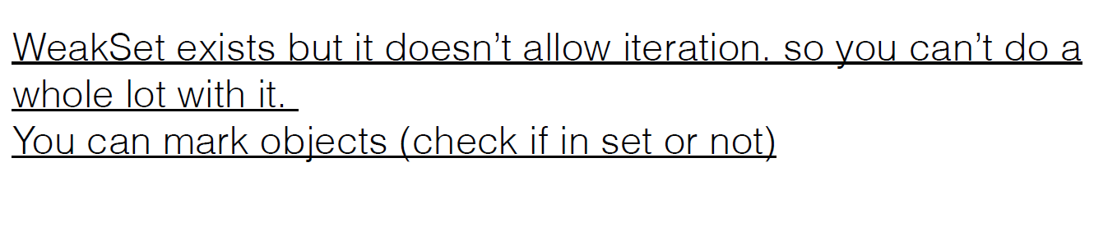
Weak set

Slide 46
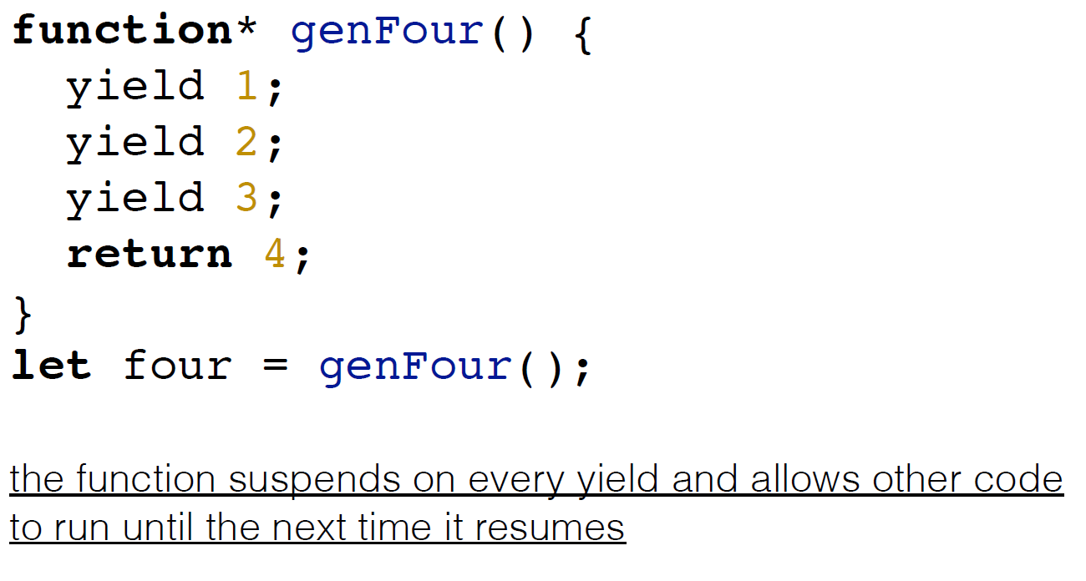
Generators

Slide 47
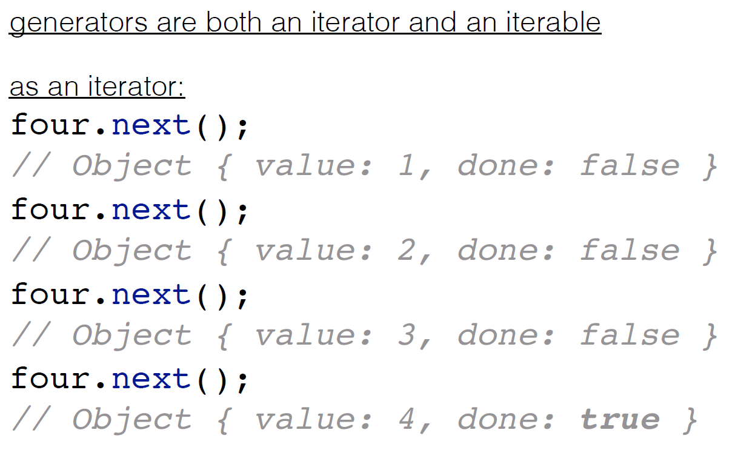
Consume generator

Slide 48
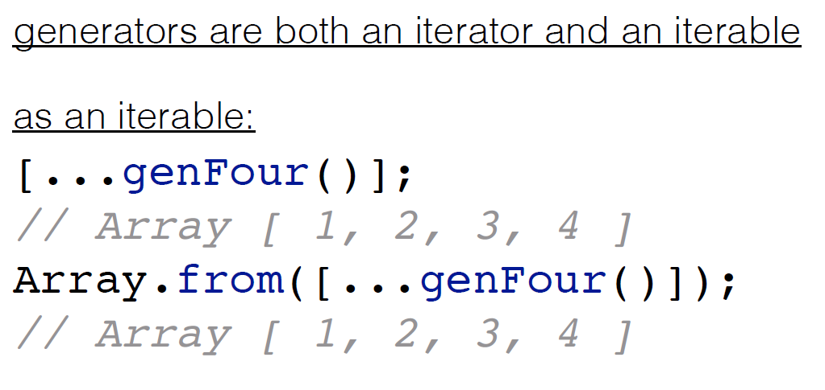
Consume generator

Slide 49
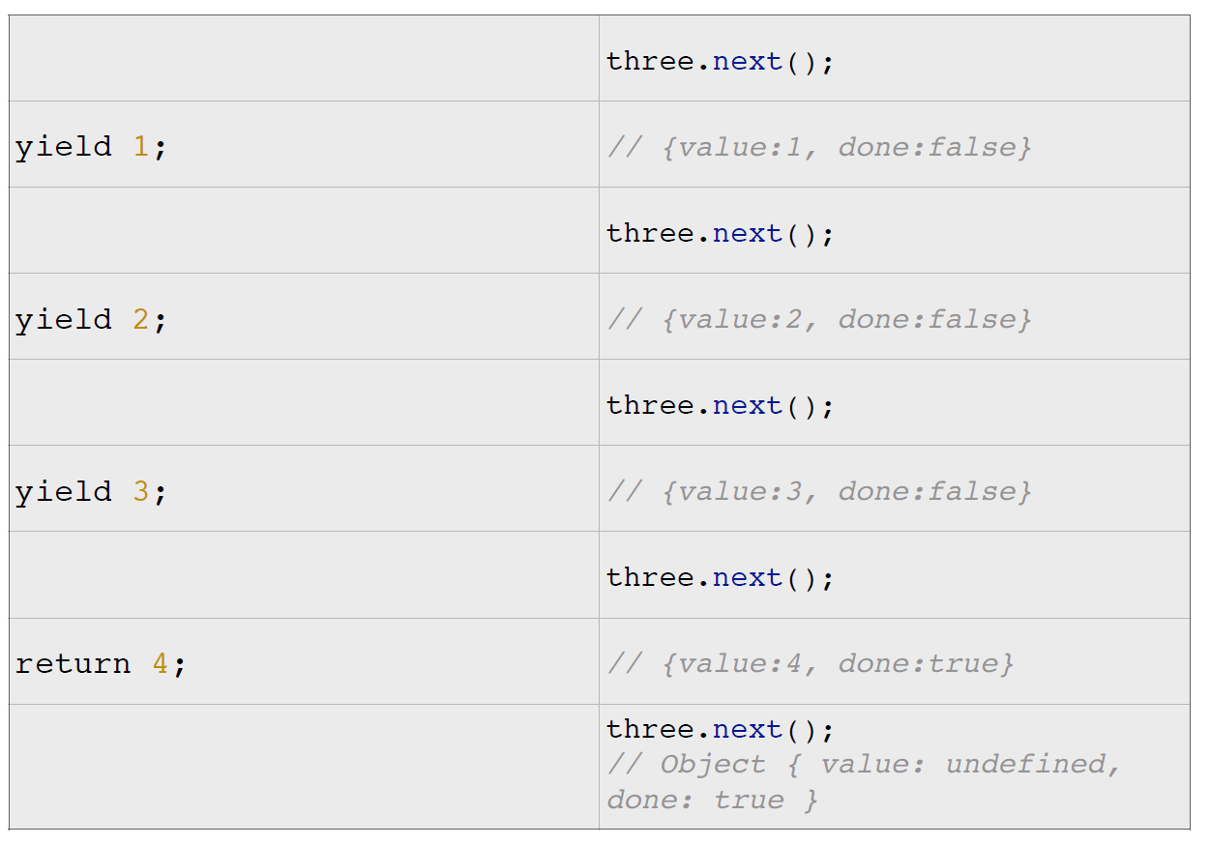
Consume generator

Slide 50
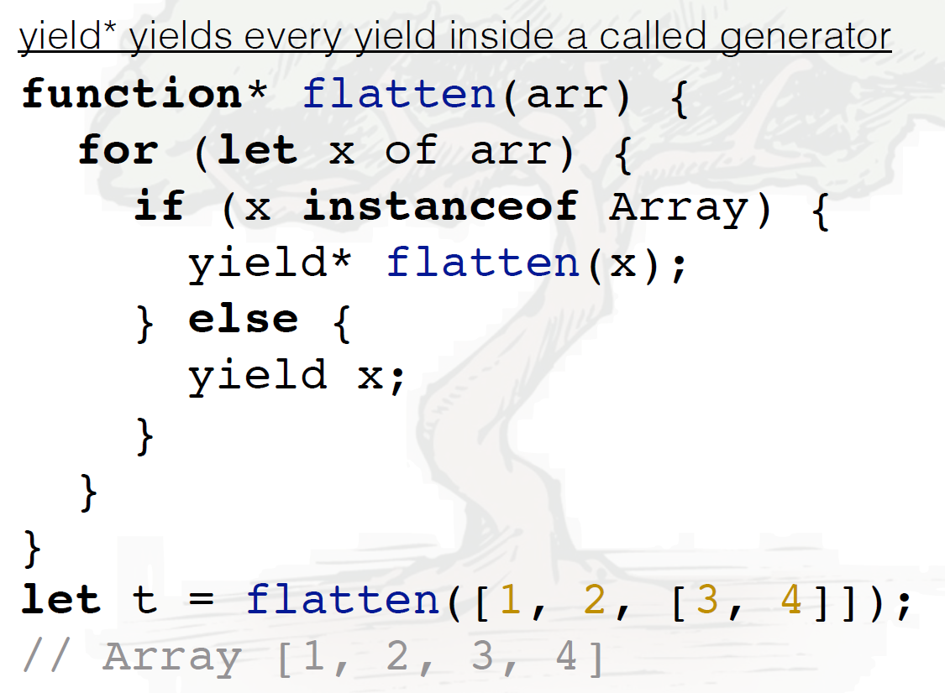
Yield*

Slide 51
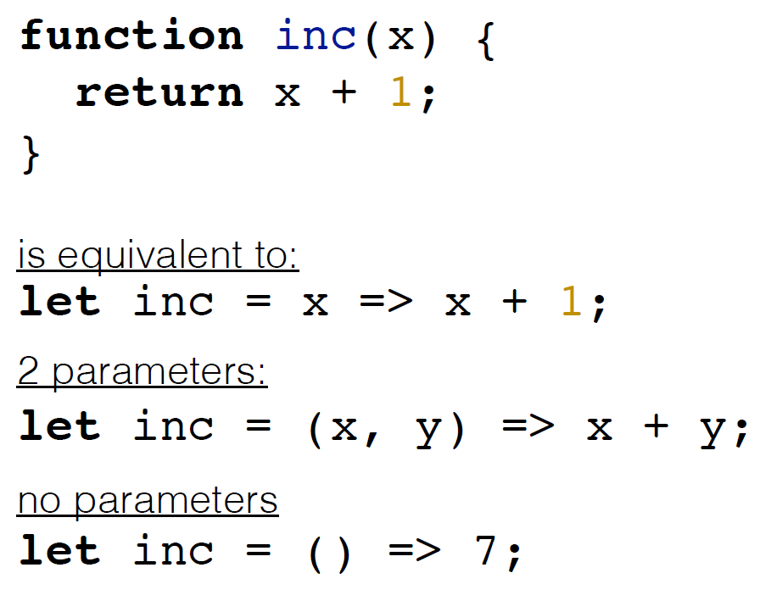
Arrow functions

Slide 52
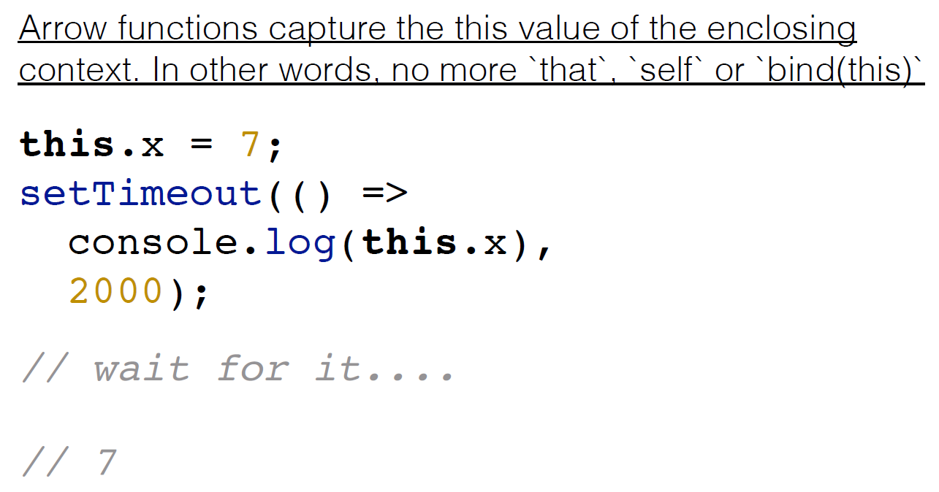
Lexical this

Slide 53

Promises

Slide 54

Promises

Slide 55

Flattering

Slide 56

Promises

Slide 57

Promises

Slide 58

Destructing

Slide 59

Destructing

Slide 60

Destructing

Slide 61

Destructing default values

Slide 62

Destructing

Slide 63

Destructing

Slide 64

Rest operator

Slide 65

Destructing

Slide 66

Spread

Slide 67

Spread

Slide 68

Modules

Slide 69

Modules

Slide 70

Modules

Slide 71

Modules

Slide 72

Proxy

Slide 73
Proxy

Slide 74
Proxy

Slide 75
Thank you for your attention

